Slide 1
Chapter 2
Control

Slide 2
Control, Quick Overview

Slide 3
Selection

Slide 4
Selection
Selection is how programs make choices, and it is the process of making choices that provides a lot of the power of computing

Slide 7
Note that == is equality,
= is assignment

Slide 8
Python if statement
if boolean expression :
suite
evaluate the boolean (True or False)
if True, execute all statements in the suite

Slide 9
Warning about indentation
Elements of the suite must all be indented the same number of spaces/tabs
Python only recognizes suites when they are indented the same distance (standard is 4 spaces)
You must be careful to get the indentation right to get suites right.

Slide 10
Python Selection, Round 2
if boolean expression:
suite1
else:
suite2
The process is:
evaluate the boolean
if True, run suite1
if False, run suite2

Slide 12
Safe Lead in Basketball
Algorithm due to Bill James (www.slate.com)
under what conditions can you safely determine that a lead in a basketball game is insurmountable?

Slide 13
The algorithm
Take the number of points one team is ahead
Subtract three
Add ½ point if team that is ahead has the ball, subtract ½ point otherwise
Square the result
If the result is greater than the number of seconds left, the lead is safe

Slide 14
Code Listing 2.3

Slide 15
first cut
Problem, what if the lead is less than 0?

Slide 16
Code Listing 2.4

Slide 17
second cut
catch the lead less than 0

Slide 18
Code Listing 2.7

Slide 20
Repetition, quick overview

Slide 21
Repeating statements
Besides selecting which statements to execute, a fundamental need in a program is repetition
repeat a set of statements under some conditions
With both selection and repetition, we have the two most necessary programming statements

Slide 22
While and For statements
The while statement is the more general repetition construct. It repeats a set of statements while some condition is True.
The for statement is useful for iteration, moving through all the elements of data structure, one at a time.

Slide 23
while loop
Top-tested loop (pretest)
test the boolean before running
test the boolean before each iteration of the loop
while boolean expression:
suite

Slide 25
repeat while the boolean is true
while loop will repeat the statements in the suite while the boolean is True (or its Python equivalent)
If the Boolean expression never changes during the course of the loop, the loop will continue forever.

Slide 26
Code Listing 2.8

Slide 28
General approach to a while
outside the loop, initialize the boolean
somewhere inside the loop you perform some operation which changes the state of the program, eventually leading to a False boolean and exiting the loop
Have to have both!

Slide 29
for and iteration
One of Python's strength's is it's rich set of built-in data structures
The for statement iterates through each element of a collection (list, etc.)
for element in collection:
suite

Slide 31
Perfect Number Example

Slide 32
a perfect number
numbers and their factors were mysterious to the Greeks and early mathematicians
They were curious about the properties of numbers as they held some significance
A perfect number is a number whose sum of factors (excluding the number) equals the number
First perfect number is: 6 (1+2+3)

Slide 33
abundant, deficient
abundant numbers summed to more than the number.
12: 1+2+3+4+6 =16
deficient numbers summed to less than the number.
13: 1

Slide 34
design
prompt for a number
for the number, collect all the factors
once collected, sum up the factors
compare the sum and the number and respond accordingly

Slide 35
Code Listing 2.10,2.11
Check Perfection
Sum Divisors

Slide 37
Improving the Perfect Number Program
Work with a range of numbers
For each number in the range of numbers:
collect all the factors
once collected, sum up the factors
compare the sum and the number and respond accordingly
Print a summary

Slide 38
Code Listing 2.13
Examine a range of numbers

Slide 40
Code Listing 2.15
Classify range of numbers

Slide 42
Control in Depth

Slide 43
Booleans

Slide 44
Boolean Expressions
George Boole's (mid-1800's) mathematics of logical expressions
Boolean expressions (conditions) have a value of True or False
Conditions are the basis of choices in a computer, and, hence, are the basis of the appearance of intelligence in them.

Slide 45
What is True, and what is False
true: any nonzero number or nonempty object. 1, 100, "hello", [a,b]
false: a zero number or empty object. 0, "",[ ]
Special values called True and False, which are just subs for 1 and 0. However, they print nicely (True or False)
Also a special value, None, less than everything and equal to nothing

Slide 46
Boolean expression
Every boolean expression has the form:
expression booleanOperator expression
The result of evaluating something like the above is also just true or false.
However, remember what constitutes true or false in Python!

Slide 47
Relational Operators
3 > 2 ➔ True
Relational Operators have low preference
5 + 3 < 3 – 2
8 < 1 ➔ False
'1' < 2 ➔ Error
can only compare like types
int('1') < 2 ➔ True
like types, regular compare

Slide 48
What does Equality mean?
Two senses of equality
two variables refer to different objects, each object representing the same value
two variables refer to the same object. The id() function used for this.

Slide 50
equal vs. same
== compares values of two variable's objects, do they represent the same value
is operator determines if two variables are associated with the same value
From the figure:
a_float == b_float → True a_float is b_float → False
b_float is c_float → True

Slide 51
Chained comparisons
In Python, chained comparisons work just like you would expect in a mathematical expression:
Given myInt has the value 5
0 <= myInt <= 5 → True
0 < myInt <= 5 > 1 → False

Slide 52
Pitfall
floating point arithmetic is approximate!

Slide 53
compare using "close enough"
Establish a level of "close enough" for equality

Slide 54
Compound Expressions
Python allows bracketing of a value between two Booleans, as in math
a_int = 5
0 <= a_int <= 10 → True
a_int >= 0 and a_int <= 10
and, or, not are the three Boolean operators in Python

Slide 55
Truth Tables

Slide 56
Truth Tables

Slide 57
Truth Tables

Slide 58
Truth Tables

Slide 59
Truth Tables

Slide 60
Compound Evaluation
Logically 0 < a_int < 3 is actually (0 < a_int) and (a_int < 3)
Evaluate using a_int with a value of 5: (0< a_int) and (a_int < 3)
Parenthesis first: (True) and (False)
Final value: False
(Note: parenthesis are not necessary in this case.)

Slide 61
Precedence & Associativity
Relational operators have precedence and associativity just like numerical operators.

Slide 62
Boolean operators vs. relationals
Relational operations always return True or False
Boolean operators (and, or) are different in that:
They can return values (that represent True or False)
They have short circuiting

Slide 63
Remember!
0, '',[ ] or other “empty” objects are equivalent to False
anything else is equivalent to True

Slide 64
Ego Search on Google
Google search uses Booleans
by default, all terms are and'ed together
you can specify or (using OR)
you can specify not (using -)
Example is:
'Punch' and ('Bill' or 'William') and not 'gates'

Slide 66
More on Assignments

Slide 67
Remember Assignments?
Format: lhs = rhs
Behavior:
expression in the rhs is evaluated producing a value
the value produced is placed in the location indicated on the lhs

Slide 68
Can do multiple assignments
a_int, b_int = 2, 3
first on right assigned to first on left, second on right assigned to second on left
print(a_int, b_int) # prints 2 3
a_int,b_int = 1,2,3 ➔ Error
counts on lhs and rhs must match

Slide 69
traditional swap
Initial values: a_int= 2, b_int = 3
Behavior: swap values of X and Y
Note: a_int = b_int
a_int = b_int doesn't work (why?)
introduce extra variable temp
temp = a_int # save a_int value in temp
a_int = b_int # assign a_int value to b_int
b_int = temp # assign temp value to b_int

Slide 70
Swap using multiple assignment
a_int, b_int = 2, 3
print(a_int, b_int) # prints 2 3
a_int, b_int = b_int, a_int
print(a_int, b_int) # prints 3 2
remember, evaluate all the values on the rhs first, then assign to variables on the lhs

Slide 71
Chaining for assignment
Unlike other operations which chain left to right, assignment chains right to left
a_int = b_int = 5
print(a_int, b_int) # prints 5 5

Slide 72
More Control: Selection

Slide 73
Compound Statements
Compound statements involve a set of statements being used as a group
Most compound statements have:
a header, ending with a : (colon)
a suite of statements to be executed
if, for, while are examples of compound statements

Slide 74
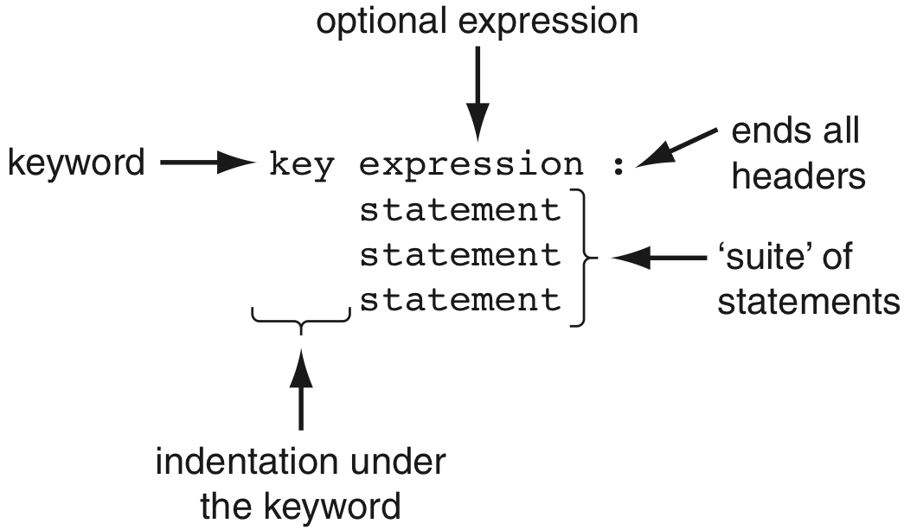
General format, suites

Slide 75
Have seen 2 forms of selection
if boolean expression:
suite
if boolean expression:
suite
else:
suite

Slide 76
Python Selection, Round 3
if boolean expression1:
suite1
elif boolean expression2:
suite2
(as many elif's as you want)
else:
suite_last

Slide 77
if, elif, else, the process
evaluate Boolean expressions until:
the Boolean expression returns True
none of the Boolean expressions return True
if a boolean returns True, run the corresponding suite. Skip the rest of the if
if no boolean returns True, run the else suite, the default suite

Slide 78
Code Listing 2.16
using elif

Slide 79
What happens if elif are replaced by if?

Slide 80
Code Listing 2.19
Updated Perfect Number classification

Slide 82
More Control: Repetition

Slide 83
Developing a while loop
Working with the loop control variable:
Initialize the variable, typically outside of the loop and before the loop begins.
The condition statement of the while loop involves a Boolean using the variable.
Modify the value of the control variable during the course of the loop

Slide 84
Issues:
Loop never starts:
the control variable is not initialized as you thought (or perhaps you don't always want it to start)
Loop never ends:
the control variable is not modified during the loop (or not modified in a way to make the Boolean come out False)

Slide 85
while loop, round two
while loop, oddly, can have an associated else suite
else suite is executed when the loop finishes under normal conditions
basically the last thing the loop does as it exits

Slide 86
while with else
while booleanExpression:
suite
suite
else:
suite
suite
rest of the program

Slide 88
Break statement
A break statement in a loop, if executed, exits the loop
It exists immediately, skipping whatever remains of the loop as well as the else statement (if it exists) of the loop

Slide 89
Code Listing 2.20
Loop, Hi Lo Game

Slide 91
Continue statement
A continue statement, if executed in a loop, means to immediately jump back to the top of the loop and re-evaluate the conditional
Any remaining parts of the loop are skipped for the one iteration when the continue was exectued

Slide 92
Code Listing 2.21
Part of the guessing numbers program

Slide 94
change in control: Break and Continue
while loops are easiest read when the conditions of exit are clear
Excessive use of continue and break within a loop suite make it more difficult to decide when the loop will exit and what parts of the suite will be executed each loop.
Use them judiciously.

Slide 95
While overview
while test1:
statement_list_1
if test2: break # Exit loop now; skip else
if test3: continue # Go to top of loop now
# more statements
else:
statement_list_2 # If we didn't hit a 'break'
# 'break' or 'continue' lines can appear anywhere

Slide 96
Range and for loop

Slide 97
Range function
The range function represents a sequence of integers
the range function takes 3 arguments:
the beginning of the range. Assumed to be 0 if not provided
the end of the range, but not inclusive (up to but not including the number). Required
the step of the range. Assumed to be 1 if not provided
if only one arg provided, assumed to be the end value

Slide 98
Iterating through the sequence
for num in range(1,5):
print(num)
range represents the sequence 1, 2, 3, 4
for loop assigns num to each of the values in the sequence, one at a time, in sequence
prints each number (one number per line)

Slide 99
range generates on demand
Range generates its values on demand

Slide 100
Hailstone example

Slide 101
Collatz
The Collatz sequence is a simple algorithm applied to any positive integer
In general, by applying this algorithm to your starting number you generate a sequence of other positive numbers, ending at 1
Unproven whether every number ends in 1 (though strong evidence exists)

Slide 102
Algorithm
while the number does not equal one
If the number is odd, multiply by 3 and add 1
If the number is even, divide by 2
Use the new number and reapply the algorithm

Slide 103
Even and Odd
Use the remainder operator
if num % 2 == 0: # even
if num % 2 == 1: # odd
if num %2: # odd (why???)

Slide 104
Code Listing 2.25
Hailstone Sequence, loop

Slide 106
The Rules
Think before you program!
A program is a human-readable essay on problem solving that also happens to execute on a computer.
The best way to imporve your programming and problem solving skills is to practice!
A foolish consistency is the hobgoblin of little minds
Test your code, often and thoroughly

